Slide 1
Airline Flight Booking System (FBS)
Professor Obinna Kalu
Team members : -
Eshetu Abebe
Jean Charles Jean Chrisner
Nigus Kidane
Yigermal Fantaye
November 2018

Slide 2
Contents
Introduction
Technologies Used
Class Diagram
Main Use Cases
Sequence Diagram
Future Extension
Demo

Slide 3
Introduction
Now a days online flight booking for airline travel has been increasingly popular and more people are flying than ever.
Easy online ticket purchase system is one of the major contributors in the increase of the passengers using air travel.
In order to have a market share in this booming market an imaginary company name X is seeking for an online Flight Booking System.

Slide 4
Introduction cont'd
To solve this problem we design and implement a working online Flight Booking System (FBS) application that allow users.
To view available flights
To book a flight.
Back-office features - provided for authorized person for system administration purpose.
Add flight Schedule
Manage Airlines, Airplanes and Airports

Slide 5
Technologies Used
Intellij IDEA and STS IDE
Spring Web/MVC
Hibernate
Spring Data
Spring Security
Hibernate Validation
Hibernate Transaction
REST Web Service
DB: MySQL

Slide 6
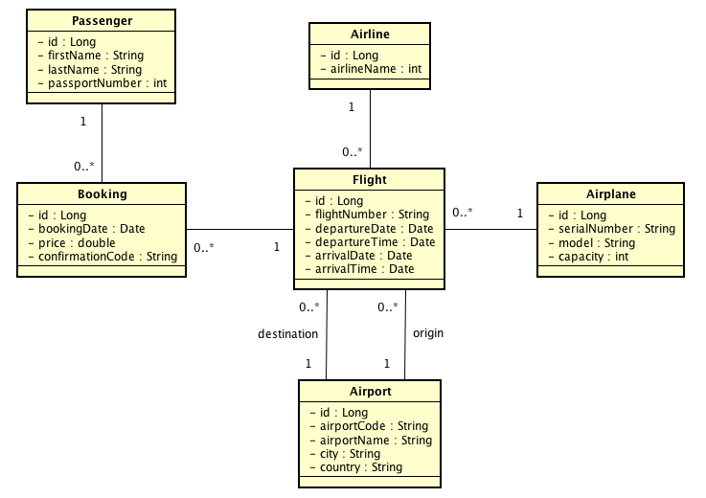
Class Diagram

Slide 7
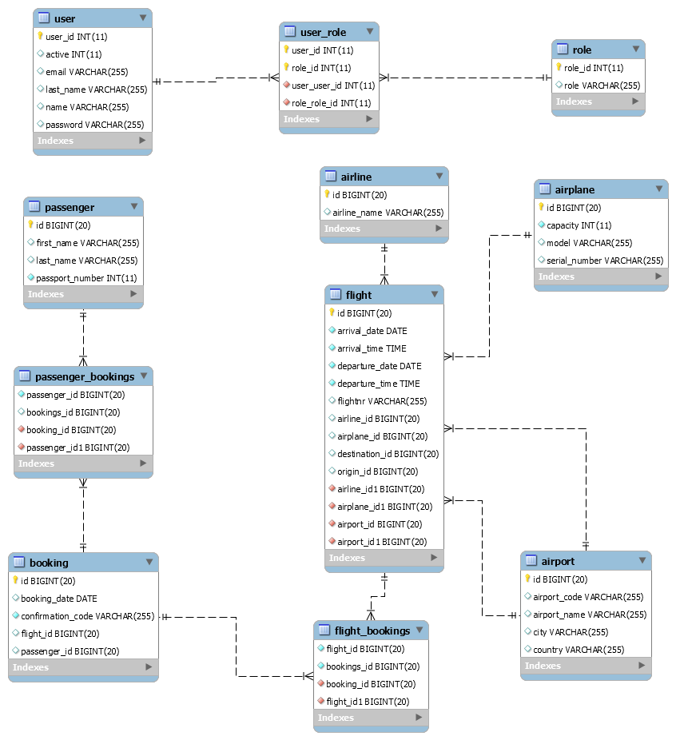
Data Base Design Model (ER Diagram)

Slide 8
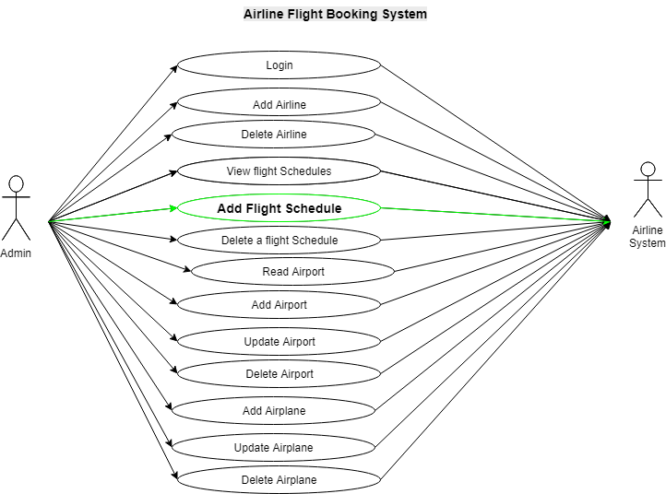
Main Use cases

Slide 9
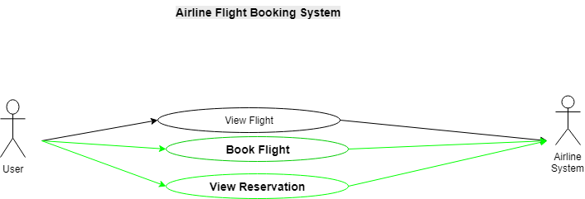
Main Use cases.. cont'd

Slide 10
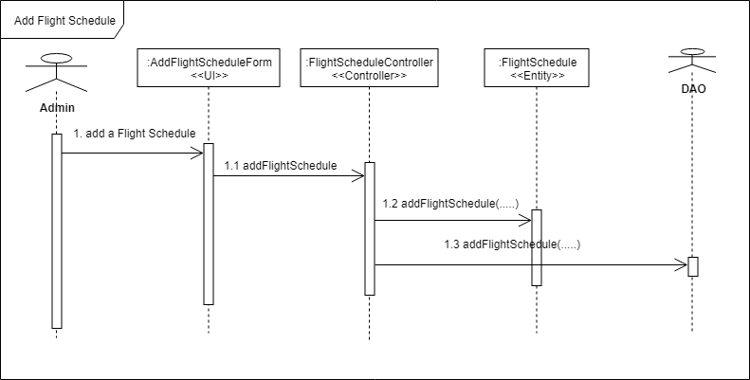
Sequence Diagram

Slide 11
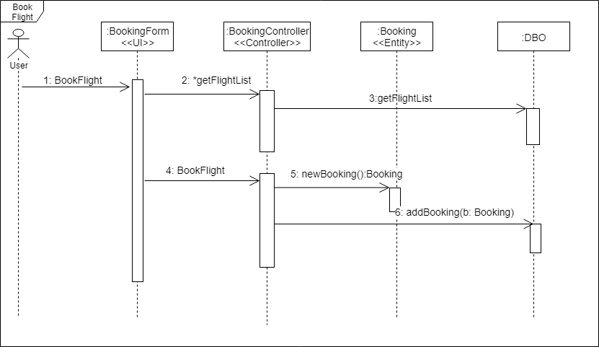
Sequence Diagram.. cont'd

Slide 12
Future Extension
Business Domain:
Customer registration and Promotion
Online checking and Flight Search
Payment
Technologies:
Mobile app
Spring Cloud and Microservices: distributed config, service discovery, routing & load balancing, etc.

Slide 13
Demo will Continue…
Thank You For Your Attention!!

